Slide 1

Chapter 7 Thinking and Intelligence

Slide 2

What is Cognition?
Cognition is thinking
Encompasses the processes associated with perception, knowledge, problem solving, judgment, language, and memory.
Cognitive psychology: examines how people think.

Slide 3
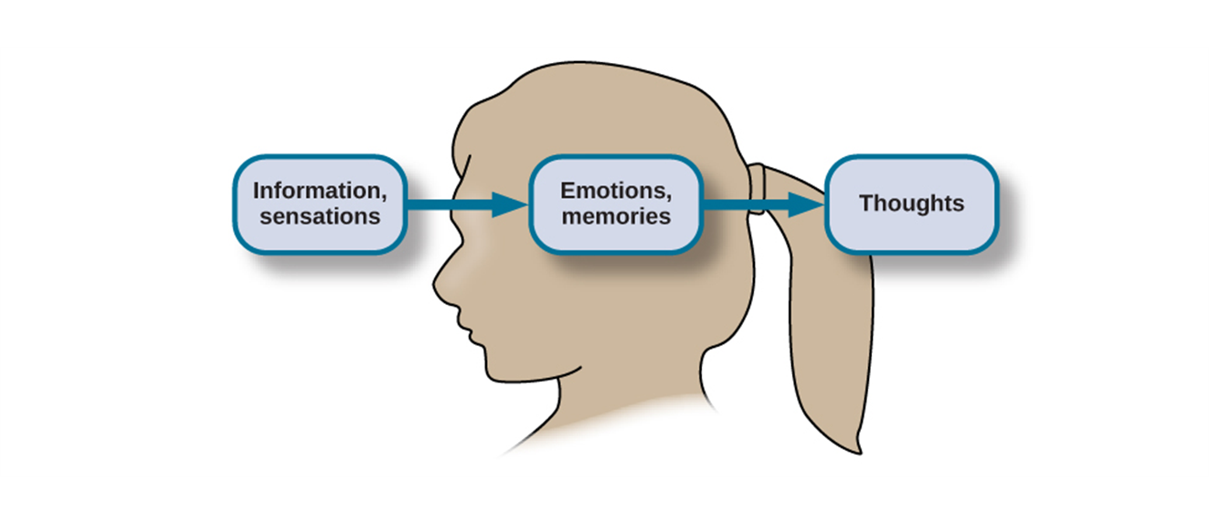
How are thoughts formed?
Sensations and information are received by our brains, filtered through emotions and memories, and processed to become thoughts.

Slide 4
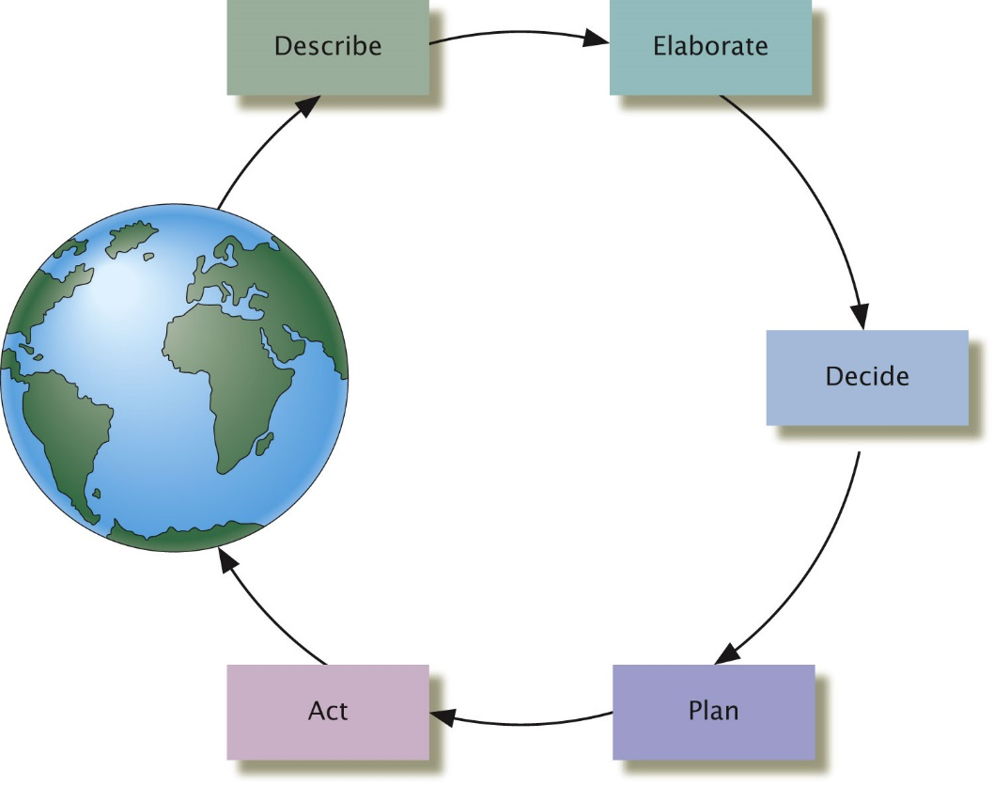
The Five Core Functions of Thought
The Circle of Thought:
Describe incoming information
Elaborate on it
Decide what to do
Plan how to do it
Act on the plan

Slide 5

Ingredients of thought: Concepts
Concepts: categories or groupings of verbal information, images, ideas, or memories.
Prototype: the best example of a natural concept.
Space shuttles and hot-air balloons are examples of the natural concept “aircraft”.
The space shuttle, with its wings and fins, is more likely to be seen as a prototype.
Concepts
Artificial concepts
Natural concepts
Prototypes
A square is an example of a artificial concept.

Slide 6


Ingredients of Thought: Schemata
Schema: A mental construct consisting of a cluster or collection of related concepts.
A way to organize information so that our brain can work more efficiently.
Role schema & Event schema

Slide 7

Language: Components
Lexicon
Words of a given language
Grammar
Rules for combining the symbols
Syntax: rules for organizing phrases and sentences
Semantics: rules about meanings

Slide 8
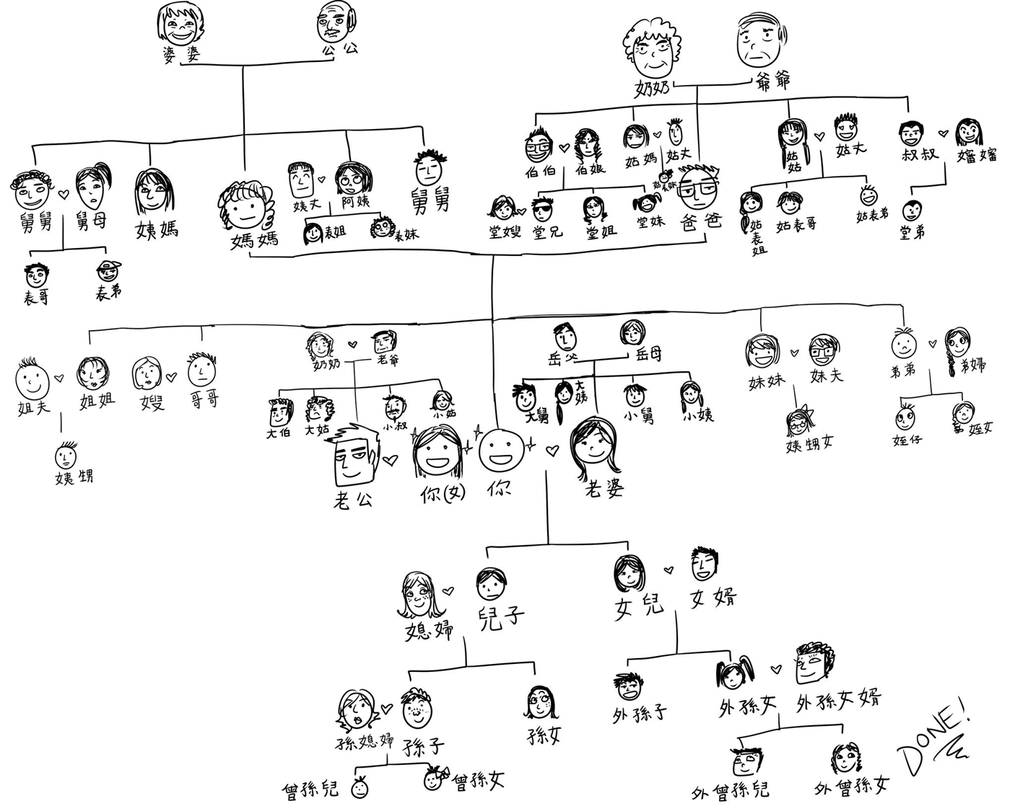

Slide 9
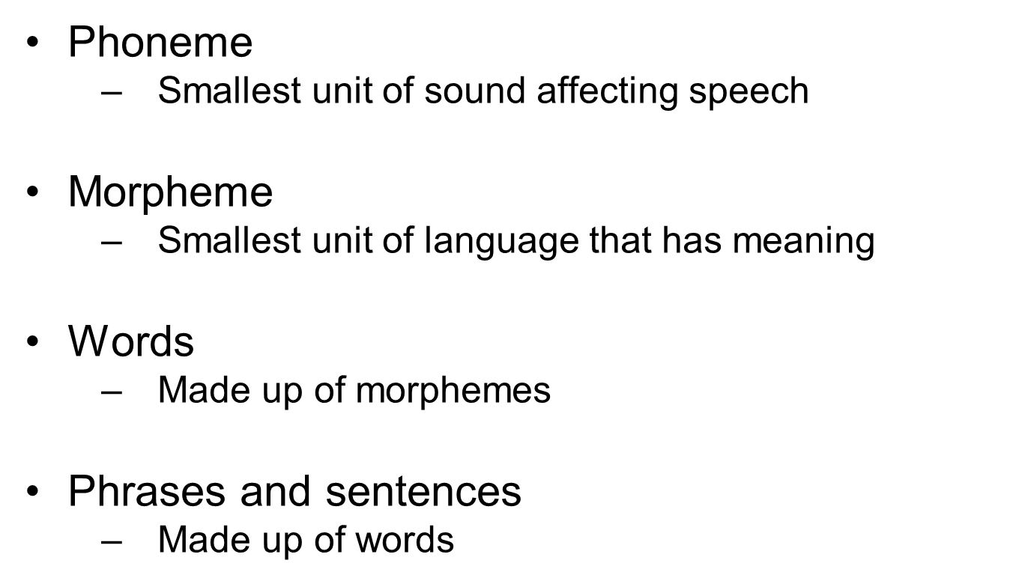
Language: Components

Slide 10
Stages of Language Development: First Year
Become increasingly attuned to important language sounds
Begin to produce infant vocalizations (babbling)
Become more complex around 9 months, and begin to sound like “sentences”
By 10-12 months can understand several words
Use nonverbal behavior to communicate
By the end of the first year, children can only discriminate among those morphemes that are used in the language(s) in their environment.

Slide 11
Stages of Language Development: Second Year
About ages 12-18 months—one-word stage
Vocabulary expands dramatically around 18 months
Start to use two word “telegraphic” sentences
Overapplication of past tense rules to irregular verbs
Sentences expanded with adjectives

Slide 12
Stages of Language Development: Third Year and Beyond
Begin to use auxiliary verbs
e.g. “Adam is going.”
Begin to ask questions using “wh-” words
What
Where
Who
Why
Begin to join clauses to form complex sentences
Acquire most grammar rules by age 5

Slide 13
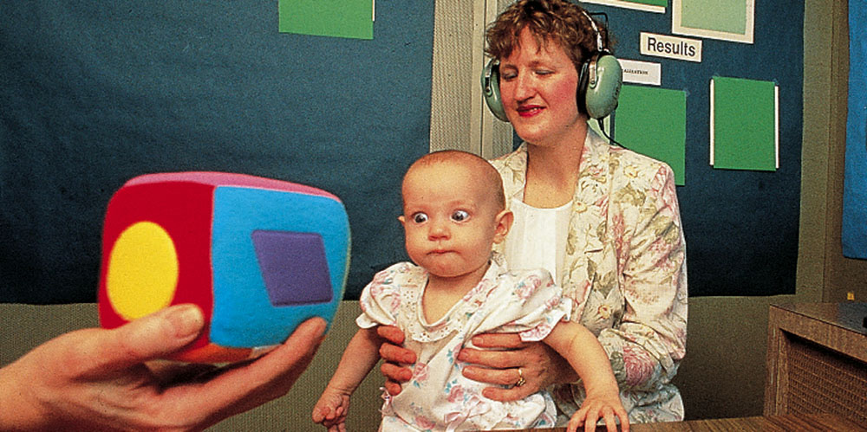
How Is Language Acquired?
Behavioral approach:
Conditioning: being rewarded for learning syntax
Modeling: imitating the speech of others

Slide 14

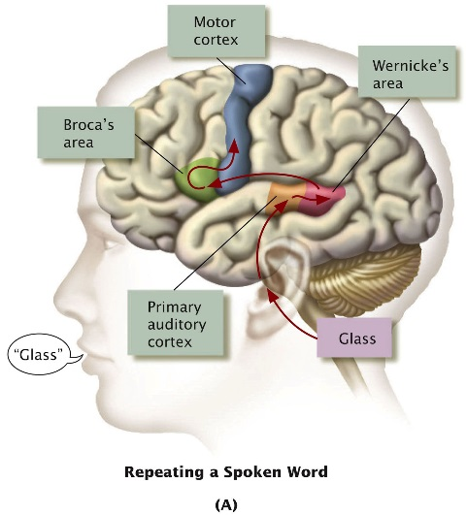
How Is Language Acquired?
Biological approach:
Noam Chomsky posited a built-in universal grammar
May reflect general cognitive development
Supporting evidence
Physiology of the mouth and throat
Specific brain regions such as Broca’s and Wernicke’s areas
Critical period for language development: The case of Genie

Slide 15
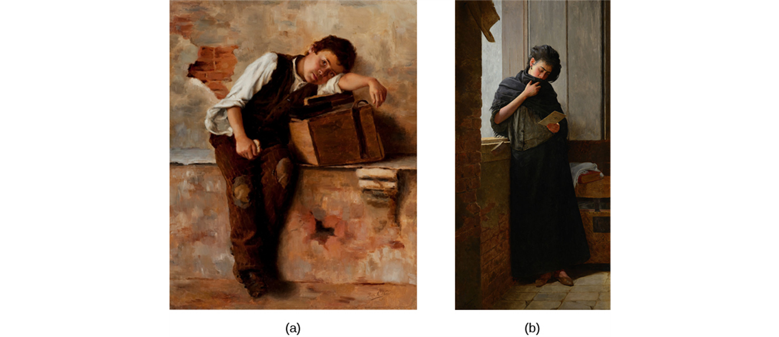
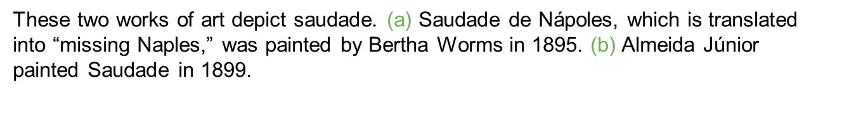
Language and Thought
Sapir-Whorf Hypothesis: Language determines thought.
Too absolute.

Slide 16
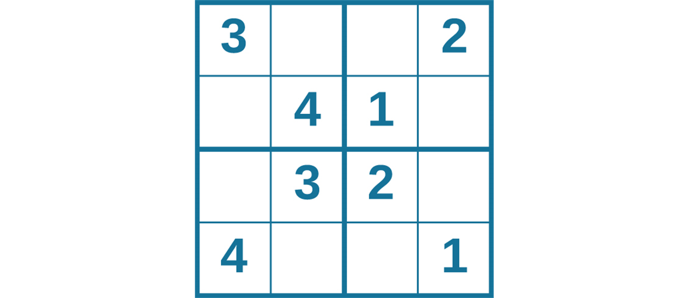
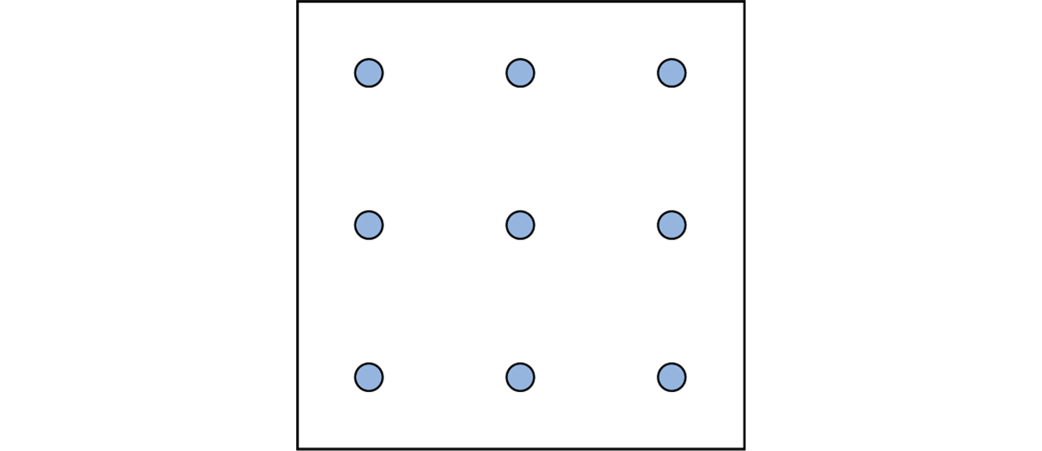

Slide 17
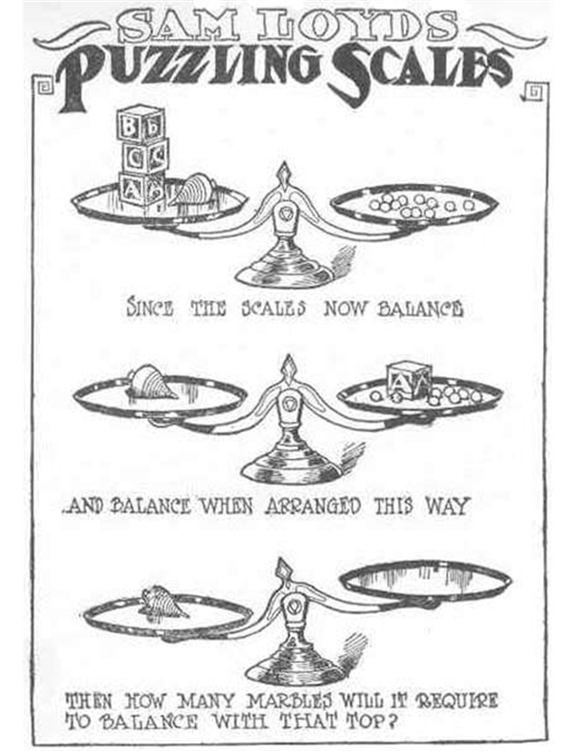

Slide 18

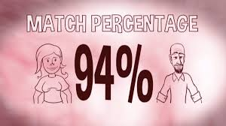
Problem-Solving Strategies
Trial and error: Continue trying different solution until problem is solved.
Algorithm: a recipe for a formula to be followed to achieve a desired outcome.

Slide 19
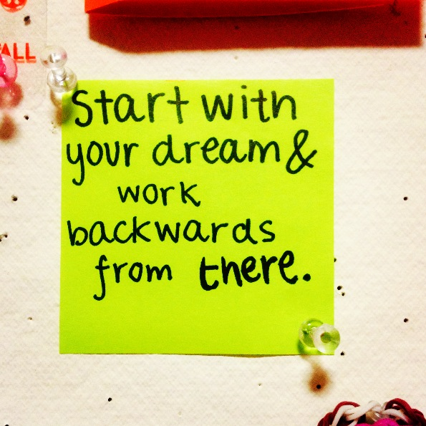
Problem-Solving Strategies
Heuristics: mental shortcuts
Used when:
Too much information
Time to make a decision is limited
Decision is unimportant
Access to limited information
Appropriate heuristic happens to come to mind in the same moment
Working backwards:
Decomposition: break a problem down into parts and tackle each part in turn.

Slide 20

Pitfalls to Problem Solving: Functional Fixedness
You cannot perceive an object being used for something other than what it was designed for
Example:
Teaching NASA astronauts to overcome functional fixedness

Slide 21
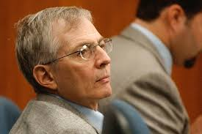
Pitfalls to Problem Solving: Confirmation Bias
Seeking only evidence supporting our beliefs
Example:
Jurors may pay little attention to evidence of defendant’s guilt if the defendant is a harmless-looking senior citizen.

Slide 22


Pitfall to Problem Solving: The Anchoring Bias
Getting stuck on (anchored to) prior information
People selling a house may anchor to their asking price.
They’ll be reluctant to accept a lower price, even if they should.
Buyers’ may anchor to the asking price. When bargaining, they’ll more likely offer 90% of the price rather than 50%.
How hard is it to change a first impression?

Slide 23


Pitfall to Problem Solving: The Representativeness Bias
Judging that something belongs to a certain group because of its similarity to some group members
We’re more likely to believe experts if they conform to our image of how an expert looks and acts

Slide 24




Pitfall to Problem Solving: The Availability Heuristic
Judgment based on ease of calling something to mind
Splashy media coverage of lottery winners makes it far easier to recall the few people who have won big prizes than the millions whose tickets were worthless
Back to TOC

